Slide 1
Dashboards with Tableau
Daria Milakhina
Associate Researcher, IPSR
dmilakhin@ku.edu
March 31, 2026

Slide 2
Structure of the workshop
Data Viz basics and best practices
Brief intro to Tableau
Build together simple dashboard
Build on your own another dashboard
At the end you’ll know how to import data, use tool tips, use filters and actions, emphasize with color, change default appearance of the chart, create calculated fields.

Slide 3
Exploratory vs Explanatory Visualizations:
Exploratory is for analysis and discovering insights. The users are analysts, data scientists, etc. Can be quick and messy.
Explanatory is for storytelling, conveying results of analysis to the user. The users are stakeholders, general public, etc. Needs to be thought through and polished.
We’ll focus on explanatory visualizations.

Slide 4
How our brain perceives visual information
Our brain takes way less time to grasp and interpret visual data than reading a text or listening to a lecture.
The brain uses past experiences to interpret ambiguous visual data, prioritizing quick understanding over perfect accuracy.
More on that: https://qbi.uq.edu.au/brain/cognition-and-behaviour/visual-perception
When creating data visualization, it matters how accurate the reader can perceive the data values.

Slide 5
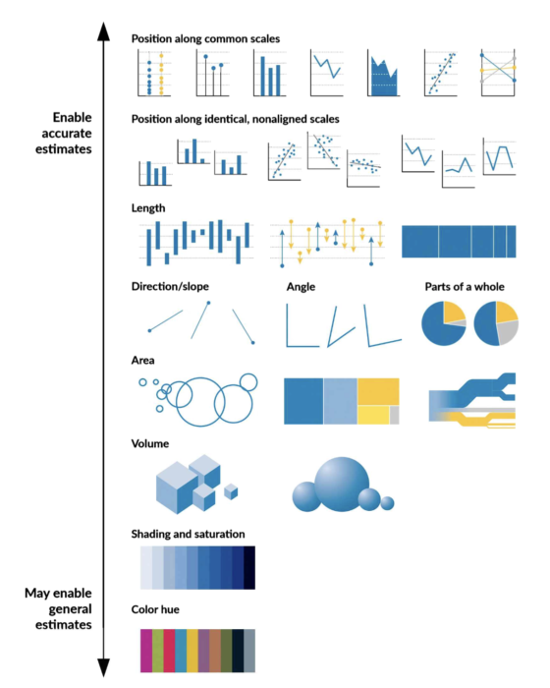
Albert Cairo(2016) perceptual ranking diagram
It is easier to compare the data in line chart, bar charts and area charts that have same axis and baseline.
Not that easy to perceive are angle, area, volume and color (e.g. bar chart vs shading in a map to depict value).

Slide 6
The basics
Start with the clear question you want to answer.
Make visuals clear, limit fonts and colors, but provide visual cues to guide the user to the main points.
Aesthetics matter. Find your style.

Slide 7
Some of the best practices
Ink/data ratio - Reduce clutter (remove axes, gridlines, tick marks, outlines, etc.)
Start with no color (everything is grey)
Tables with numbers < graphs
Don’t be afraid to explain how to read/interpret the graph – Full sentence titles and labels, annotations, instructions on how to interact, etc.
Check for accessibility (at the very least – how it prints black and white)
Align using numbers/coordinates, not visual check
Most viewers scan web content starting at the top left of a web page. Order visuals accordingly.
Tailor your graphics for the type of the reader (general public, scholars, policy makers, etc…)
You can’t assume the reader is paying attention to details

Slide 8
Example Data table (it’s ok):

Slide 9
Default Excel chart (not terrible):

Slide 10
Cleaned up (better)
Reduced clutter by removing axes, grid lines, etc.
Color for emphasis
Labels on the bars for more straightforward understanding of data

Slide 11
A side note about pie charts
This is subjective, but here is why you shouldn’t be using them ever:
Our eyes have hard time judging angles
Circle is hard to label cleanly
Because of the above many people have strong preference against pie charts
There is a perfect substitute – horizontal stacked bars
Because of the above very not many people have preference in favor of pie charts
So, why annoy first group of people?

Slide 12
Just to illustrate….
Data source: It’s made up, but that’s how it feels to me

Slide 13
A side note about technical statistical graphs:
Maybe use them for academic papers (or don’t)
Don’t use them for general public. Figure out the main message you want to present and find a simple graph for that.
If you must use them for general public – overexplain what everything means.

Slide 14
Resources:
To check for accessibility
https://bioapps.byu.edu/colorblind_image_tester
Color combinations, check for contrast, color blindness:
https://color.adobe.com/create/color-wheel
Books and Websites:
Storytelling with data, Cole Nussbaumer Knaflic, https://www.storytellingwithdata.com/
The Visual Display of Quantitative Information Edward Tufte, https://www.edwardtufte.com/
Better Data Visualizations Jonathan Schwabish, https://policyviz.com/
UC Davis Coursera Tableau series:
https://www.coursera.org/specializations/data-visualization
Tableau Help is a useful fist stop, specifically here is an article about order of operations:
https://help.tableau.com/current/pro/desktop/en-us/order_of_operations.htm

Slide 15
Inspirations:
Excellent style for visuals:
https://www.nytimes.com/spotlight/graphics
https://www.pewresearch.org/short-reads/2025/12/15/our-favorite-data-visualizations-of-2025/
https://abcnews.com/538/26-charts-helped-explain-2024-politics/story?id=116925033
https://www.tableau.com/blog/most-favorited-data-visualizations-tableau-public
Learning from mistakes with explanations:
https://medium.economist.com/mistakes-weve-drawn-a-few-8cdd8a42d368
https://analythical.com/blog/examples-of-awful-data-visualization

Slide 16
Why Tableau?
Pros:
Easy interface
Excellent interactivity features
Great maps (easier to set up than ArcGIS, better than Power BI)
Easier to customize than tools that rely heavily on programming.
Sleek visuals even if you don’t want to customize (though you do want to customize!)
Marketable skill
Excellent for exploratory analysis
Cons:
Cleaning data in Tableau is painful – Power BI does a better job
Costly

Slide 17
Free Tableau options to sharpen your skills
Tableau Public. Allows to share your vizzes, however all of them are in public access. Don’t use with sensitive data! Not all features of desktop version work. Great to embed into website or for practice.
Tableau Desktop Free Version. Just released. Can’t share vizzes, can save pictures into pdf. Excellent practice tool! Download it and play with it!
Tableau Desktop Public Edition. Limits data to 15M rows, can share to Tableau Public.

Slide 18
Data structures for Tableau
Tableau can use data from various sources and in many formats
For learning purposes, most of the time you’ll have spreadsheets
Data needs to be tall and skinny
Labels in first row
In the lowest dimension you’ll need to show. General recommendation is to disaggregate, but you have a lot of data - you might need to use totals for faster processing
Tableau splits variables into dimensions (categories) or measures (numeric value)
Create relationships between different datasets if you need them to work together.
Generally, avoid cleaning data in Tableau

Slide 19
Software check
Let’s make sure you:
Either created an account in Tableau Public or downloaded Tableau Desktop Free Edition
Downloaded data and instructions for exercise one and two.

Slide 20
Let’s just jump right in
Exercise one:
Using data on KS population by year by county, we will:
- Create a dashboard there shows map of KS with counties color coded by whether the population increased of decreased in the last 40 years.
- Include a pie chart with the percentage of KS population by county. Just kidding, we won’t.
- Add interactive features: when user clicks on a county – show a graph with population numbers for all 4 years of data.
- Change the default formatting to best practices.

